Slide 1
TOPIC A:
DATABASES
LESSON A-2
DATABASE TRANSACTIONS

Slide 2
AGENDA
Warm-up Question
Transactions
States
Updates
Data Consistency
Data Integrity
Database Transactions
Concurrency
ACID Properties
Data Validation
NOTE!
Have a way to take notes available for this lesson

Slide 3

THE WARM UP QUESTION
What information might you be able to infer from the following data?
36.12, 13.78
449.99
Sam Mulligan
12/13/19

Slide 4
THE WARM UP ANSWER
36.12, 13.78: GPS Coordinates, Graph Coordinates
449.99: Price of item
Sam Mulligan: Name of person, maybe brand
12/13/19: Date

Slide 5

TRANSACTIONS
Let’s take, for example, a bank’s database
If I want to move money from account A to account B:
Money must be withdrawn from account A
Money must be deposited into account B
These actions TOGETHER comprise ONE database transaction

Slide 6
TRANSACTIONS
What happens if only one of those two changes takes place in the database?

Slide 7
STATES
If only the withdrawal succeeds, but the deposit fails for some reason
The state of your account is rolled back before any changes were made at all
So you don’t lose money
For a transaction to be completed, every change must succeed
Whenever the rollback occurs it reverts to a known well state

Slide 8
TRANSACTIONS
A transaction is simply a ‘unit’ of work performed on a database with a few tasks accomplished in a specific, logical order
Transactions change one or more things about the database
Adding/deleting/updating records from table
We must control transactions to ensure the database remains stable and consistent

Slide 9
TRANSACTIONS
Transactions have two main purposes:
Allow for recovery from failures to correct states
Provide isolation between multiple programs accessing the database at once (so two transactions don’t mess with the same data at the same time)
Database transactions adhere to a principle called ACID

Slide 10
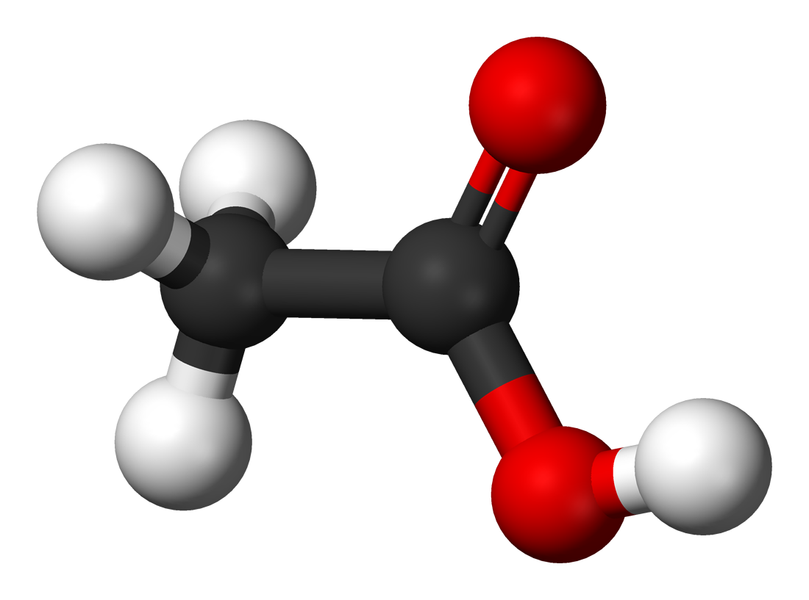
ACID
ACID is an acronym referring to four principles of database transactions
Atomicity – all operations within the transaction are completed successfully, or they get rolled back
Consistency – ensures database properly changes states upon a successful transaction
Isolation – enables transactions to operate independently of each other
Durability – Ensures the result of a transaction is maintained even if the system fails

Slide 11
TRANSACTIONS
Transactions in larger databases are often kept track of by ID inside of the database
Transactions can contain smaller sub-transactions for more complex operations, ensuring their atomicity

Slide 12
CONSISTENCY
Consistency is the principle that ensures that if you attempt to add data to a database that isn’t valid (putting a string in an integer field for example) it will be rolled back to the previous state
This prevents the database or related programs from having errors when you attempt to store or retrieve this data

Slide 13
INTEGRITY
Data Integrity is similar to consistency, in that it is to prevent invalid data in a database
Instead of preventing data that isn’t of the right type, data integrity prevents data that doesn’t fall within the right bounds
Let’s look at a few examples

Slide 14
INTEGRITY
For the field “Birth Date”, providing the data of “Jeff” would be inconsistent data
For this same field, the dates “4/12/1821” or “9/10/2200” could be handled by data integrity constraints
Assuming that the database is intended to hold data about current customers

Slide 15
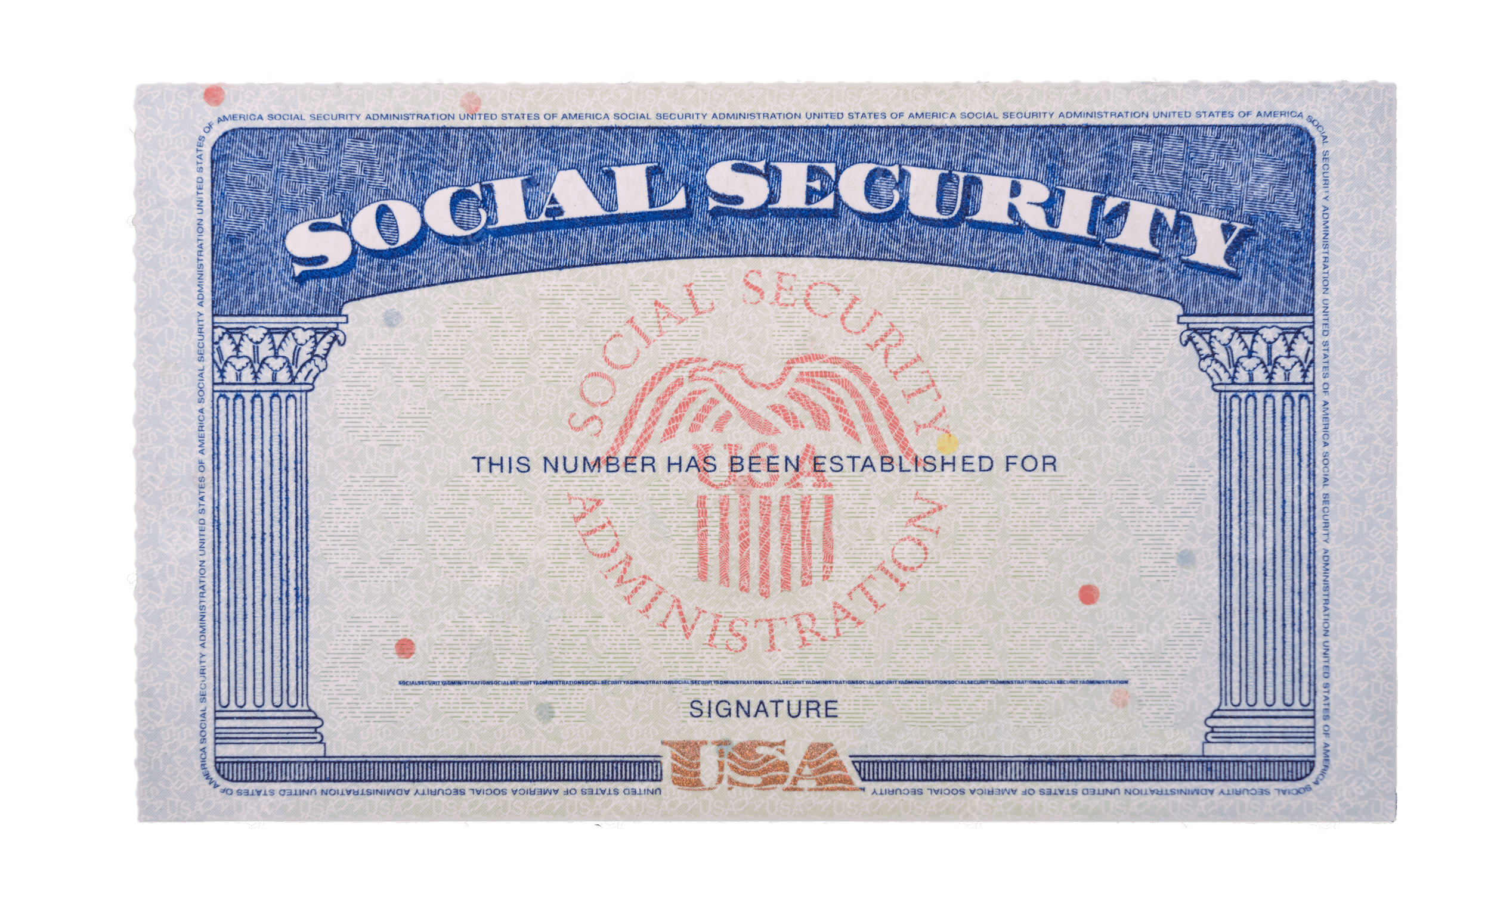
INTEGRITY
Another example could be for the field “Social Security Number”, where inconsistent data could be “False”
In this same instance, data integrity could prevent you from entering “444-444-4444”
Recall that social security numbers need to be of the format “XXX-XX-XXXX”

Slide 16
CONCURRENCY
Concurrency in a data sharing situation ensures that a Database Management System (DBMS) is able to handle multiple users attempting to retrieve, modify, or store data at once
If two users try and modify data at the same time, what should happen?

Slide 17
DATA VALIDATION
Both consistency and integrity can be considered Data Validation
Data validation simply refers to ensuring that data complies with the data requirements of the system to avoid errors

Slide 18
PROGRAMMING ASSIGNMENT
They’re back and better than ever!

